Slide 1
Project Anime Manga Analysis
Luu Quynh Thanh Nguyen

Slide 2
Abstract
Anime analysis.
Manga analysis.
The most and least successful anime adaptation.
Aim:
Building a ELT pipeline, working with DBT and Dagster.
Understand the work of Data Analytics Engineer.

Slide 3
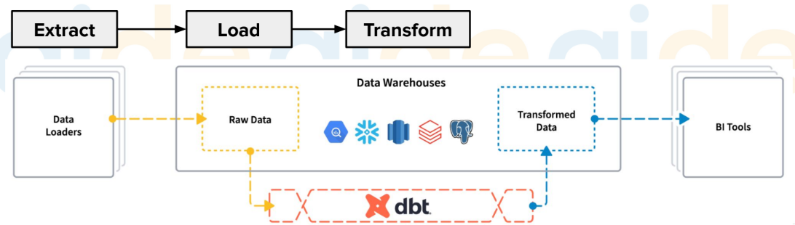
Processing

Slide 4
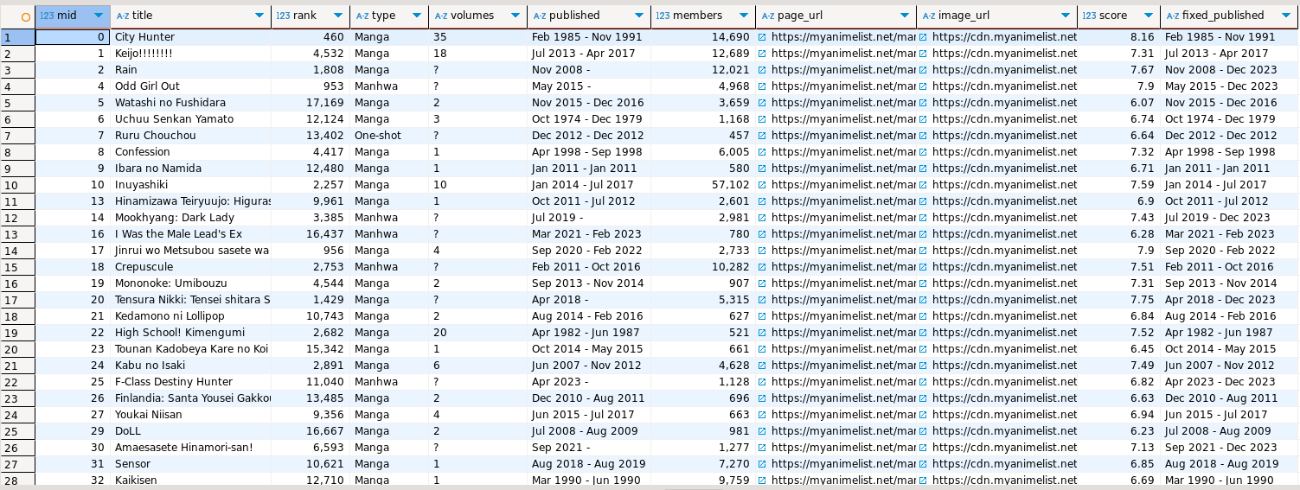
Results
Transformed Data in Postgresql

Slide 5
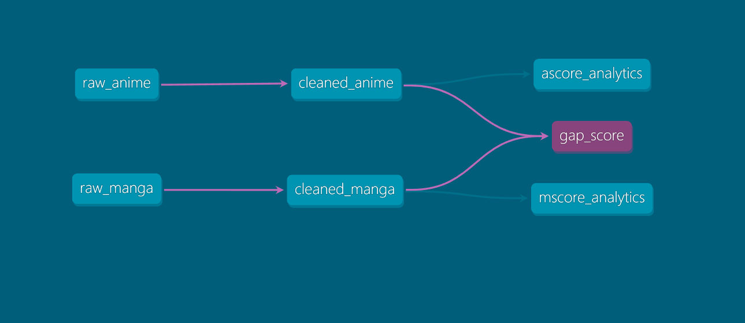
Results
DBT View Lineage Graph

Slide 6
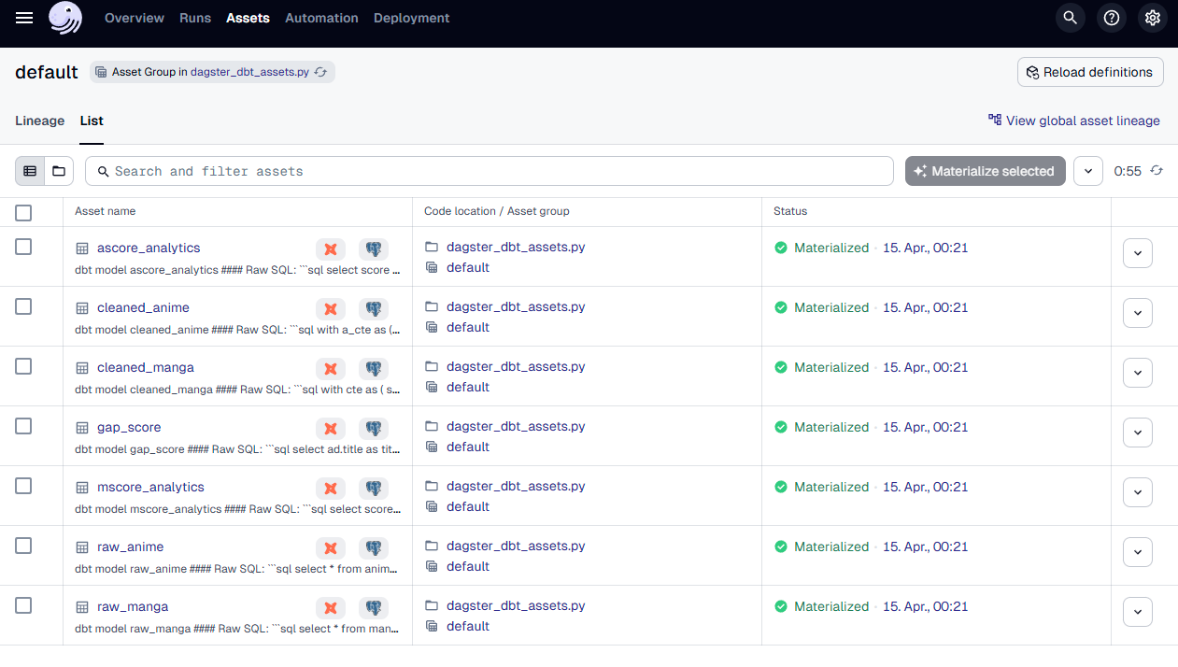
Results
Materialized Assets in Dagster

Slide 7
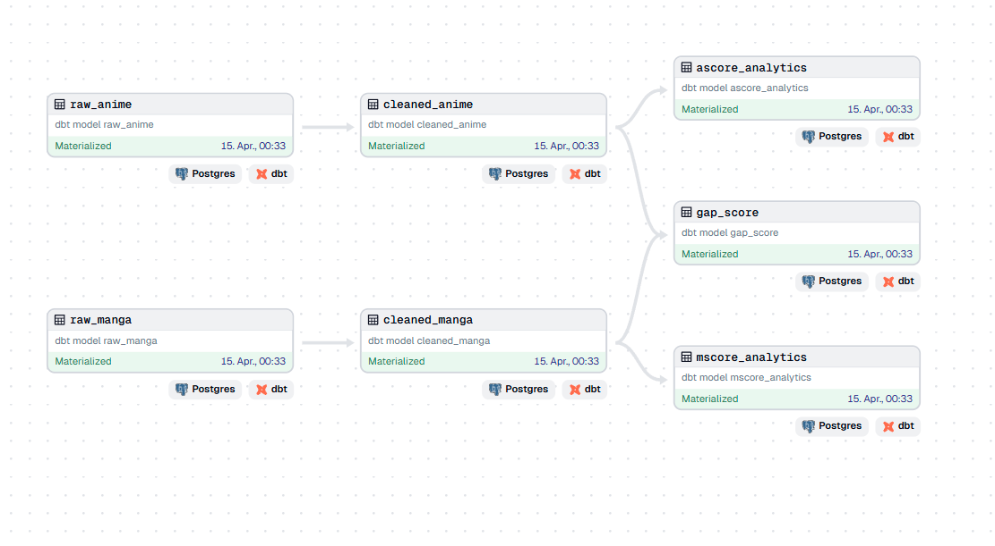
Results
Dagster DAG

